Slide 1
Homework #10 Discussion
Do you allow for underemployed (idle) workers?
How do you account for training as a two-week process? What about the trainers?
Are all your constraints equalities? If so, is that appropriate?
Does an inventory DV contribute to or detract from demand?
What could/should be integer-restricted if you weren’t being asked to model this as an LP?

Slide 2
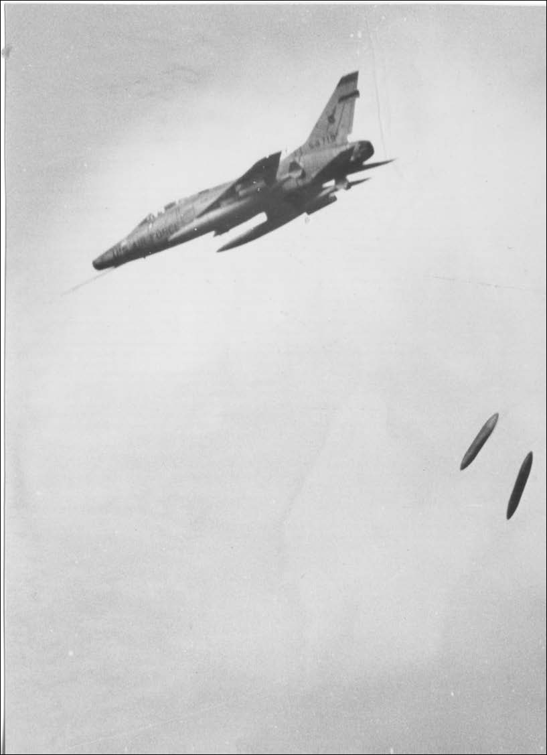
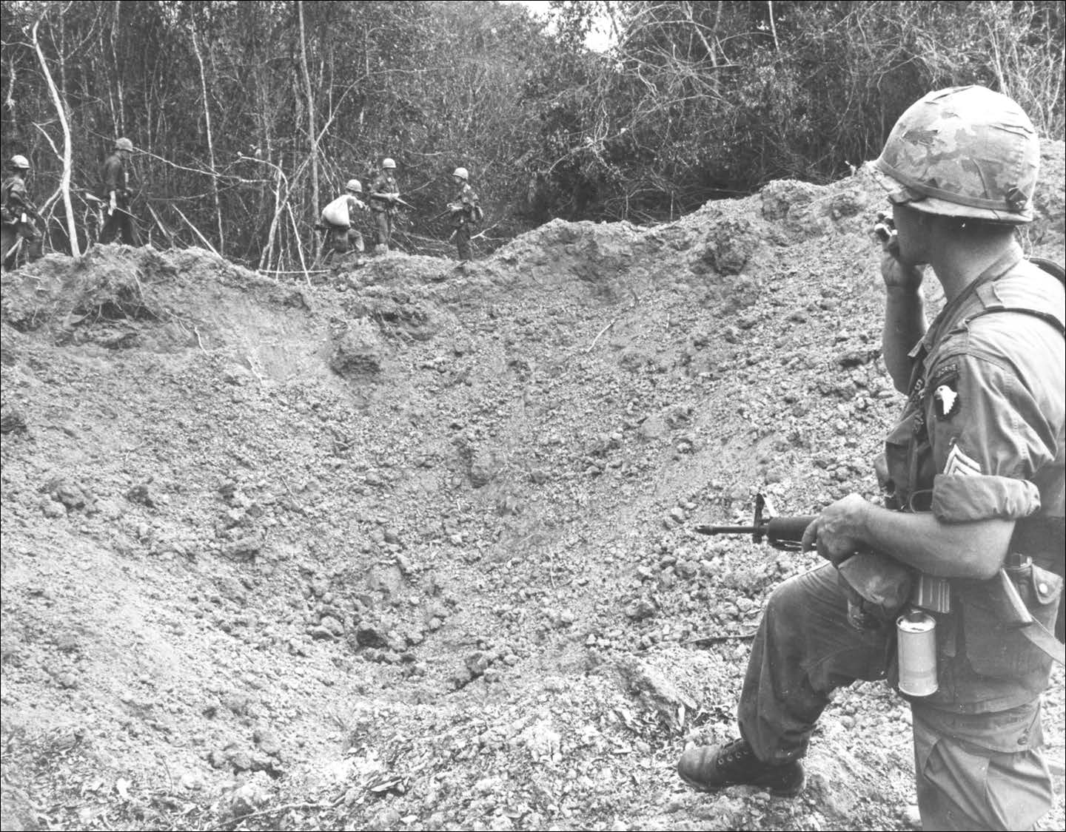
Primary strike bomber used in VN
20,000 sorties were flown by this AC in VN
62 operational losses
Notes:
The F-105 was one of the primary attack aircraft of the Vietnam War; over 20,000 Thunderchief sorties were flown, with 382 aircraft lost including 62 operational losses (out of the 833 produced). Although less agile than smaller MiG fighters, USAF F-105s were credited with 27.5 kills.

Slide 3

OPER 610 Lesson 15 Interior Point Methods 1A: Karmarkar’s Projective Algorithm
1957 –
Dr Brian J. Lunday
Office: Rm 201E, Bldg 641

Slide 4
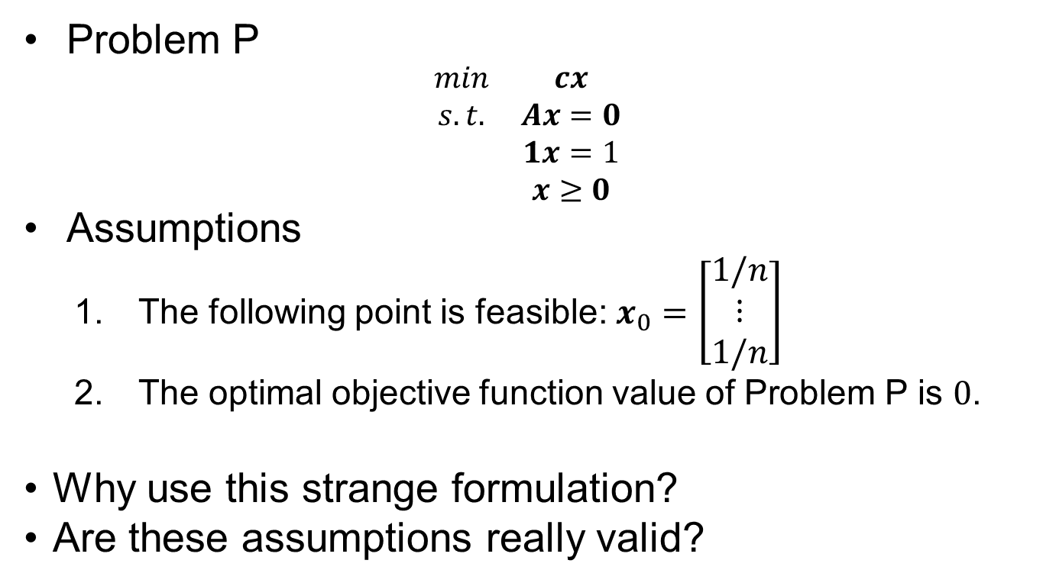
Basic Problem & Assumptions
Problem P
$$\begin{matrix}min & cx \\ s.t. & Ax=0 \\ & 1x=1 \\ & x≥0\end{matrix}$$
Assumptions
The following point is feasible: $x_{0}=\left[\begin{aligned}1/n \\ ⋮ \\ 1/n\end{aligned}\right]$
The optimal objective function value of Problem P is $0$.
Why use this strange formulation?
Are these assumptions really valid?

Slide 5
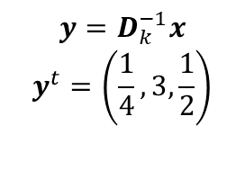
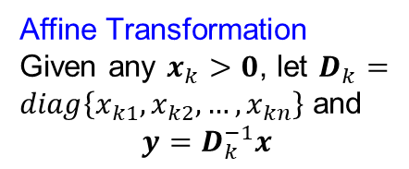
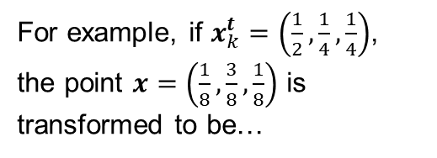
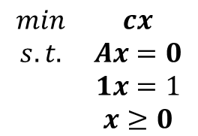
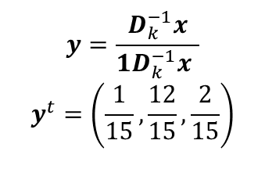

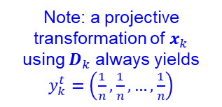
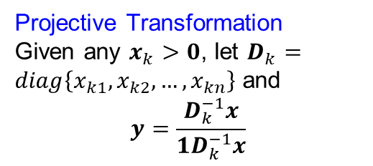

A Few Possible Transformations
$$\begin{matrix}min & cx \\ s.t. & Ax=0 \\ & 1x=1 \\ & x≥0\end{matrix}$$
Affine Transformation
Given any $x_{k}>0$, let $D_{k}=diag\left\{x_{k1},x_{k2},…,x_{kn}\right\}$ and
$$y=D_{k}^{−1}x$$
Projective Transformation
Given any $x_{k}>0$, let $D_{k}=diag\left\{x_{k1},x_{k2},…,x_{kn}\right\}$ and
$$y=\frac{D_{k}^{−1}x}{1D_{k}^{−1}x}$$
For example, if $x_{k}^{t}=\left(\frac{1}{2},\frac{1}{4},\frac{1}{4}\right)$, the point $x=\left(\frac{1}{8},\frac{3}{8},\frac{1}{8}\right)$ is transformed to be…
$$y=D_{k}^{−1}x$$
$$y^{t}=\left(\frac{1}{4},3,\frac{1}{2}\right)$$
$$y=\frac{D_{k}^{−1}x}{1D_{k}^{−1}x }$$
$$y^{t}=\left(\frac{1}{15},\frac{12}{15},\frac{2}{15}\right)$$
$$y≥0$$
Note: a projective transformation of $x_{k}$ using $D_{k}$ always yields $y_{k}^{t}=\left(\frac{1}{n},\frac{1}{n},…,\frac{1}{n}\right)$
$$1y=1$$
$$y≥0$$

Slide 6



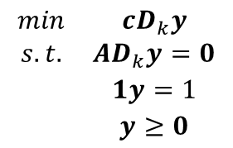
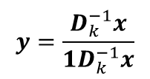

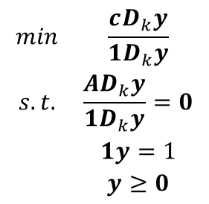

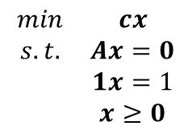


On the Projective Transformation
Identifying the Inverse Transformation
Transforming the Optimization Problem
$$y=\frac{D_{k}^{−1}x}{1D_{k}^{−1}x}$$
$$\begin{matrix}min & cx \\ s.t. & Ax=0 \\ & 1x=1 \\ & x≥0\end{matrix}$$
$$D_{k}y=\frac{x}{1D_{k}^{−1}x}$$
$$x=D_{k}y\left(1D_{k}^{−1}x\right)$$
$$\begin{matrix}min & \frac{cD_{k}y}{1D_{k}y} \\ s.t. & \frac{{AD}_{k}y}{1D_{k}y}=0 \\ & 1y=1 \\ & y≥0\end{matrix}$$
$$1x=\left({1D}_{k}y\right)\left(1D_{k}^{−1}x\right)$$
$$1x=1$$
Why?
$$1=\left({1D}_{k}y\right)\left(1D_{k}^{−1}x\right)$$
$$\left(1D_{k}^{−1}x\right)=\frac{1}{\left({1D}_{k}y\right)}$$
Why is this step acceptable?
$$\begin{matrix}min & cD_{k}y \\ s.t. & {AD}_{k}y=0 \\ & 1y=1 \\ & y≥0\end{matrix}$$
$$x=\frac{D_{k}y}{1D_{k}y}$$

Slide 7


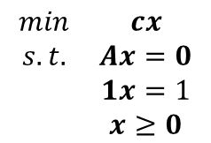
















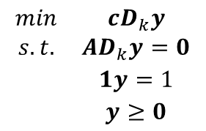




The Problem and the Projectively Transformed Problem
$$\begin{matrix}min & cx \\ s.t. & Ax=0 \\ & 1x=1 \\ & x≥0\end{matrix}$$
$$\begin{matrix}min & cD_{k}y \\ s.t. & {AD}_{k}y=0 \\ & 1y=1 \\ & y≥0\end{matrix}$$
(n=3, m=1 example shown)
$$x_{3}$$
$$y_{3}$$
$$\left(0,0,1\right)$$
$$\left(0,0,1\right)$$
$$c=∇f(x)$$
$$cD_{k}=∇f(y)$$
$$\left(\frac{1}{3},\frac{1}{3},\frac{1}{3}\right)$$
$$x_{2}$$
$$\left(\frac{1}{3},\frac{1}{3},\frac{1}{3}\right)$$
$$y_{2}$$
$$\left(0,1,0\right)$$
$$\left(0,1,0\right)$$
$$Ax=0$$
But we don’t know this distance
$$AD_{k}y=0$$
We can bound this distance!
$$x≥0$$
$$y≥0$$
$$1x=1$$
$$1y=1$$
$$\left(1,0,0\right)$$
$$\left(1,0,0\right)$$
$$x_{1}$$
$$y_{1}$$

Slide 8
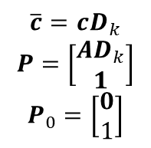
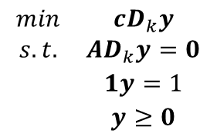
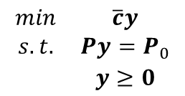
Simplifying the Representation of the Transformed Problem
$$\begin{matrix}min & cD_{k}y \\ s.t. & {AD}_{k}y=0 \\ & 1y=1 \\ & y≥0\end{matrix}$$
$$\overline{c}=cD_{k}$$
$$P=\left[\begin{aligned}AD_{k} \\ 1\end{aligned}\right]$$
$$P_{0}=\left[\begin{aligned}0 \\ 1\end{aligned}\right]$$
$$\begin{matrix}min & \overline{c}y \\ s.t. & Py=P_{0} \\ & y≥0\end{matrix}$$
Equation for a hyperplane in the positive orthant

Slide 9

























The Projectively Transformed Problem
Illustration ($n=3,m=1$)
Illustration ($n=4,m=1$)
$$y_{3}$$
$$\left(0,0,1\right)$$
$$B\left(y_{0},r\right)∩\left\{1y=1\right\}$$
$$1y=1$$
$$B\left(y_{0},αr\right)∩\left\{1y=1\right\}$$
$$cD_{k}=∇f(y)$$
$$B\left(y_{0},r\right)∩\left\{1y=1\right\}$$
$$B\left(y_{0},αr\right)∩\left\{y:Py=P_{0}\right\}$$
$$Py=P_{0}$$
$$y_{0}$$
$$y_{2}$$
$$y_{0}$$
$$\left(0,1,0\right)$$
$$y_{new}$$
$$y_{new}$$
$$AD_{k}y=0$$
$$B\left(y_{0},αr\right)∩\left\{1y=1\right\}$$
$$B\left(y_{0},αr\right)∩\left\{y:Py=P_{0}\right\}$$
$$y≥0$$
$$1y=1$$
Why set $<1$? To “keep iterates positive.
Why is that important?
What is the disadvantage of this technique?
$$\left(1,0,0\right)$$
$$y_{1}$$

Slide 10
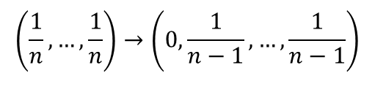

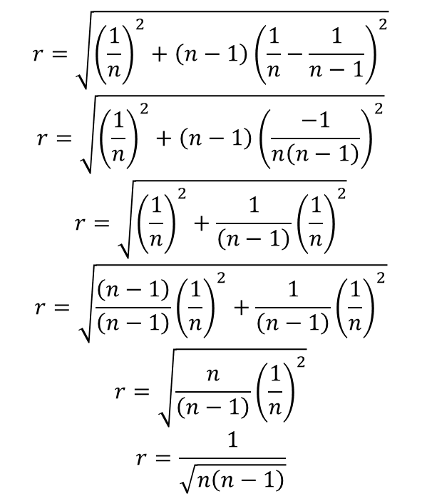
What is $r$?
The Euclidean distance from the center of the simplex to the center of one of its facets.
$$r=\sqrt{{\left(\frac{1}{n}\right)}^{2}+\left(n−1\right){\left(\frac{1}{n}−\frac{1}{n−1}\right)}^{2}}$$
$$r=\sqrt{{\left(\frac{1}{n}\right)}^{2}+\left(n−1\right){\left(\frac{−1}{n\left(n−1\right)}\right)}^{2}}$$
$$r=\sqrt{{\left(\frac{1}{n}\right)}^{2}+\frac{1}{\left(n−1\right)}{\left(\frac{1}{n}\right)}^{2}}$$
$$r=\sqrt{\frac{\left(n−1\right)}{\left(n−1\right)}{\left(\frac{1}{n}\right)}^{2}+\frac{1}{\left(n−1\right)}{\left(\frac{1}{n}\right)}^{2}}$$
$$r=\sqrt{\frac{n}{\left(n−1\right)}{\left(\frac{1}{n}\right)}^{2}}$$
$$r=\frac{1}{\sqrt{n\left(n−1\right)}}$$
$$\left(\frac{1}{n},…,\frac{1}{n}\right)→\left(0,\frac{1}{n−1},…,\frac{1}{n−1}\right)$$

Slide 11


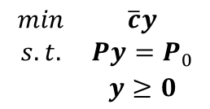






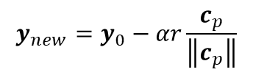

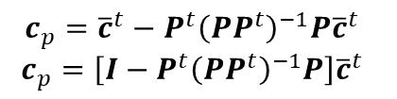

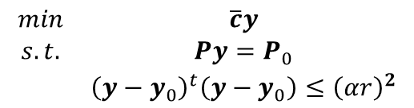

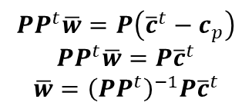
What’s our new iterate?
$$\begin{matrix}min & \overline{c}y \\ s.t. & Py=P_{0} \\ & y≥0\end{matrix}$$
$$\begin{matrix}min & \overline{c}y \\ s.t. & Py=P_{0} \\ & {\left(y−y_{0}\right)}^{t}\left(y−y_{0}\right)≤{\left(αr\right)}^{2}\end{matrix}$$
$${\overline{c}}^{t}$$
$${\overline{c}}^{t}−c_{p}$$
$$B\left(y_{0},αr\right)∩\left\{y:Py=P_{0}\right\}$$
$$c_{p}$$
$$y_{new}$$
$$y_{0}$$
What is $cp$?
$$y_{new}=y_{0}−αr\frac{c_{p}}{\left\|c_{p}\right\|}$$
$P^{t}\overline{w}={\overline{c}}^{t}−c_{p}$ for some $\overline{w}$
What’s does this come from?
$$c_{p}={\overline{c}}^{t}−P^{t}\overline{w}$$
$$PP^{t}\overline{w}=P\left({\overline{c}}^{t}−c_{p}\right)$$
$$PP^{t}\overline{w}=P{\overline{c}}^{t}$$
$$\overline{w}={\left(PP^{t}\right)}^{−1}P{\overline{c}}^{t}$$
Why?
What is the next $xk$?
$$x=\frac{D_{k}y}{1D_{k}y}$$
$$c_{p}={\overline{c}}^{t}−P^{t}{\left(PP^{t}\right)}^{−1}P{\overline{c}}^{t}$$
$$c_{p}=\left[I−P^{t}{\left(PP^{t}\right)}^{−1}P\right]{\overline{c}}^{t}$$

Slide 12
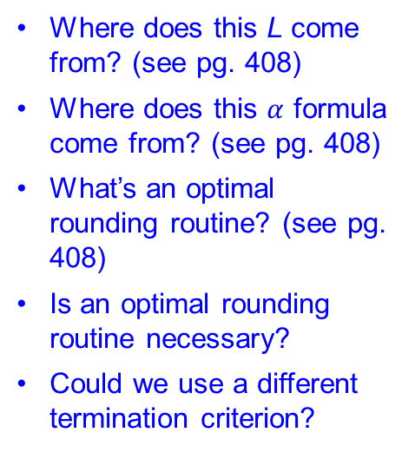
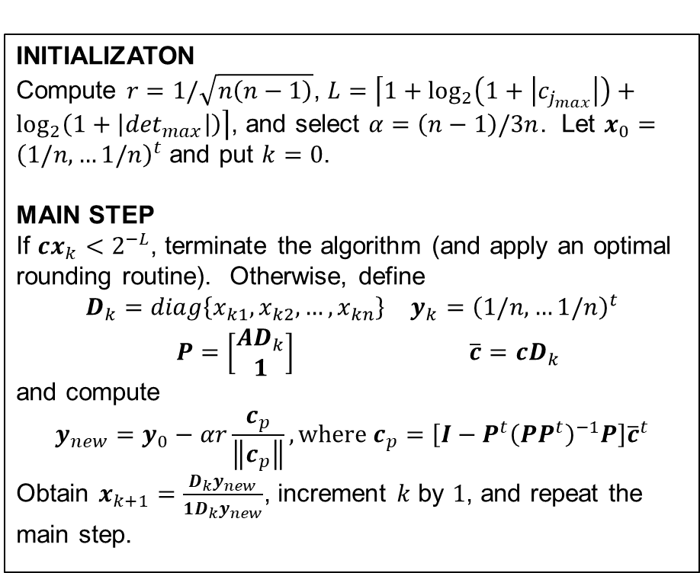
Karmarkar’s Algorithm
INITIALIZATON
Compute $r=1/\sqrt{n\left(n−1\right)}$, $L=\left\lceil 1+\log_{2}\left(1+\left|c_{j_{max}}\right|\right)+\log_{2}\left(1+\left|\det_{max}\right|\right)\right\rceil$, and select $α=\left(n−1\right)/3n$. Let $x_{0}={\left(1/n,…1/n\right)}^{t}$ and put $k=0$.
MAIN STEP
If $cx_{k}<2^{−L}$, terminate the algorithm (and apply an optimal rounding routine). Otherwise, define
$$\begin{matrix}D_{k}=diag\left\{x_{k1},x_{k2},…,x_{kn}\right\} & y_{k}={\left(1/n,…1/n\right)}^{t} \\ P=\left[\begin{aligned}AD_{k} \\ 1\end{aligned}\right] & \overline{c}=cD_{k}\end{matrix}$$
and compute
$$y_{new}=y_{0}−αr\frac{c_{p}}{\left\|c_{p}\right\|}, where c_{p}=\left[I−P^{t}{\left(PP^{t}\right)}^{−1}P\right]{\overline{c}}^{t}$$
Obtain $x_{k+1}=\frac{D_{k}y_{new}}{1D_{k}y_{new}}$, increment $k$ by $1$, and repeat the main step.
Where does this L come from? (see pg. 408)
Where does this $α$ formula come from? (see pg. 408)
What’s an optimal rounding routine? (see pg. 408)
Is an optimal rounding routine necessary?
Could we use a different termination criterion?

Slide 13
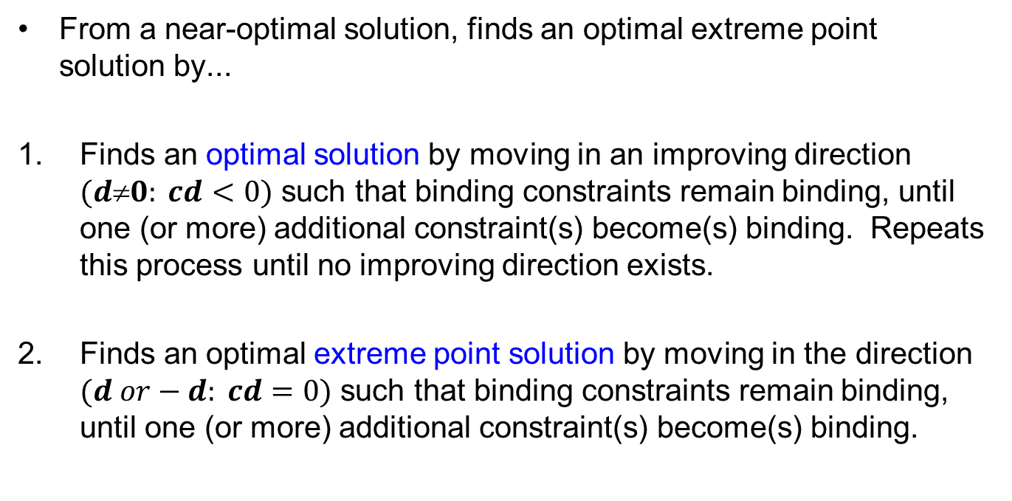
Optimal Rounding Routine (i.e., Purification Scheme)
From a near-optimal solution, finds an optimal extreme point solution by...
Finds an optimal solution by moving in an improving direction $(d0: cd<0)$ such that binding constraints remain binding, until one (or more) additional constraint(s) become(s) binding. Repeats this process until no improving direction exists.
Finds an optimal extreme point solution by moving in the direction $(d or−d: cd=0)$ such that binding constraints remain binding, until one (or more) additional constraint(s) become(s) binding.

Slide 14
Questions & Discussion

Slide 15
For Next Class
Section 8.4 (pp 414-417): Karmarkar’s Algorithm.
Identify how to transform any LP into the form required by Karmarkar’s Algorithm
Identify the order in which the assumptions are met by the sequence of transformations
Homework #12: Problem 1.6 (Phase 2)
Note the textbook errata.
Include your manual formulation from Phase 1, updated and/or corrected as appropriate
Model the compact formulation in Python/Pyomo to leverage the indices on decision variables and constraints to write a shorter (denser) formulation
Import the parametric data (including sets) from an external (.xls, .xlsx, or .csv) file

